Slide 1

Javascript tools and workflow
ZVONIMIR BUŠIĆ

Slide 2

Tools used in modern Javascript development
workflow
Code quality tools - ESlint
Debugging tools - Chrome DevTools

Slide 3

Code quality tool: ESlint
linter - tool that analyzes code and checks for programming errors, possible bugs and stylistic errors
ESlint - pluggable and extendable javascript linting utility
has good integration with most used editors/IDEs
installation - npm install eslint --save-dev
create configuration file - .eslintrc.(json,yaml,js)

Slide 4
ESlint: configuration
env - defines in which environment will code be run and adds global variables
parserOptions - defines what javascript language version to use
extends - defines what config to use as base (if any)
rules - defines additional rules and rule overrides

Slide 5
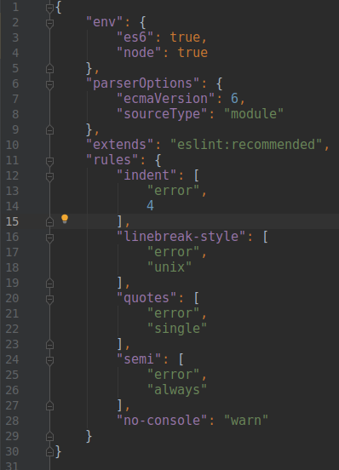
Example
Notes:
Add this config to and run eslint via npm script with some code that has console.log

Slide 6
Debugging tool: Node inspector with Chrome DevTools
Chrome DevTools is powerful developer tool used for debugging nodejs and web applications
it allows runtime code inspection, adding logpoints and breakpoints to code that’s executed
Notes:
Create some expample with code debugging in browser

